Slide 1
Knowledge Doc – PCF Deployment Basics
August - 2017

Slide 2
Table of Contents
Table Of Contents
Objective
Pre Requisites
PCF – CLI Setup
Deployment with PCF – CLI
PCF – STS Plugin & Cloud Foundry Server Setup
Deployment with PCF Plugin
Next Steps

Slide 3
Objective & Pre Requisites
Objective
Main objective is to learn on how to utilize both PCF CLI and PCF STS Plugins to deploy the application in PCF
This involves setting up the CLI / Plugin and
Executing commands / events to deploy the application
Pre Requisites
Have a PCF account – Login to https://login.sys.eas.pcf.manulife.com/login with you LAN ID and Password
Access to PCF SANDBOX environment and your own Space
STS installed
Simple hello world Spring Boot application
ARC – Chrome REST Client Plugin to test the REST Service (Or any other REST Client)

Slide 4
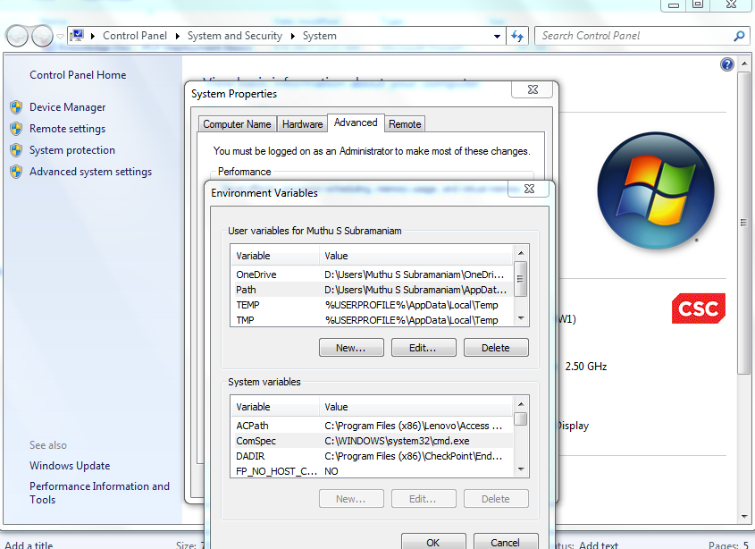
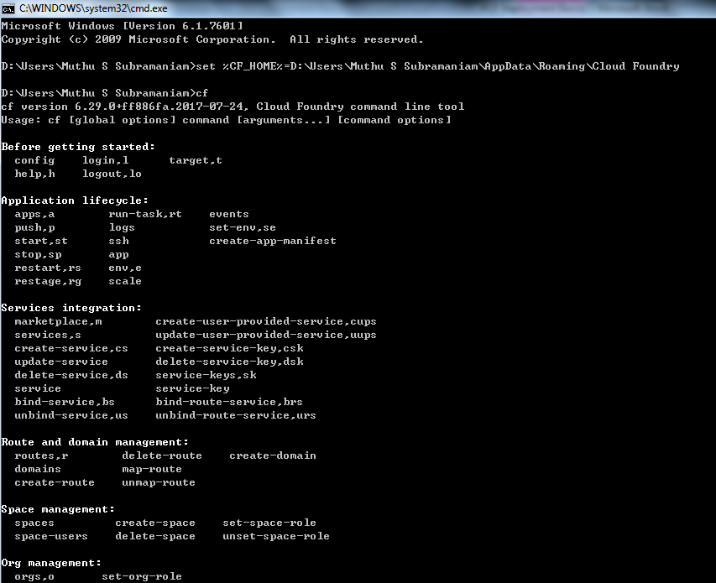
PCF – CLI Setup
Step 1
Install PCF CLI using the following URL
https://docs.cloudfoundry.org/cf-cli/install-go-cli.html
Step 2
Set the environment variables so that the CF command can be run from any directory
This can be done either by setting the Path variable in System Properties or through command line

Slide 5
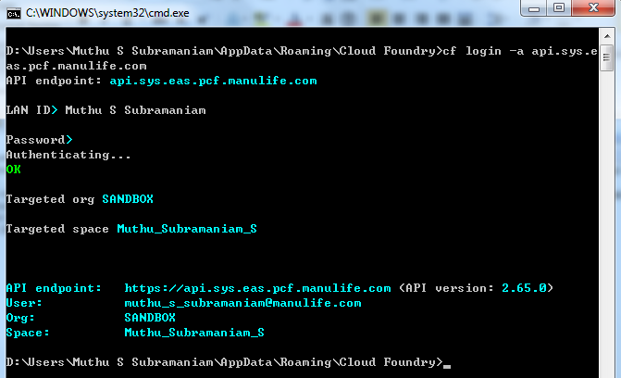
Deployment with PCF – CLI (1/3)
Step 1
Open the command prompt and login to PCF environment using the following command (cf login -a api.sys.eas.pcf.manulife.com)
Enter the LAN ID and Password when prompted
Step 2
Validate the Org (Sandbox) and the Space in the output of the login command. If different then execute the following command to deploy in sandbox environment within the space provided for you
cf target -o SANDBOX -s Muthu_Subramaniam_S

Slide 6
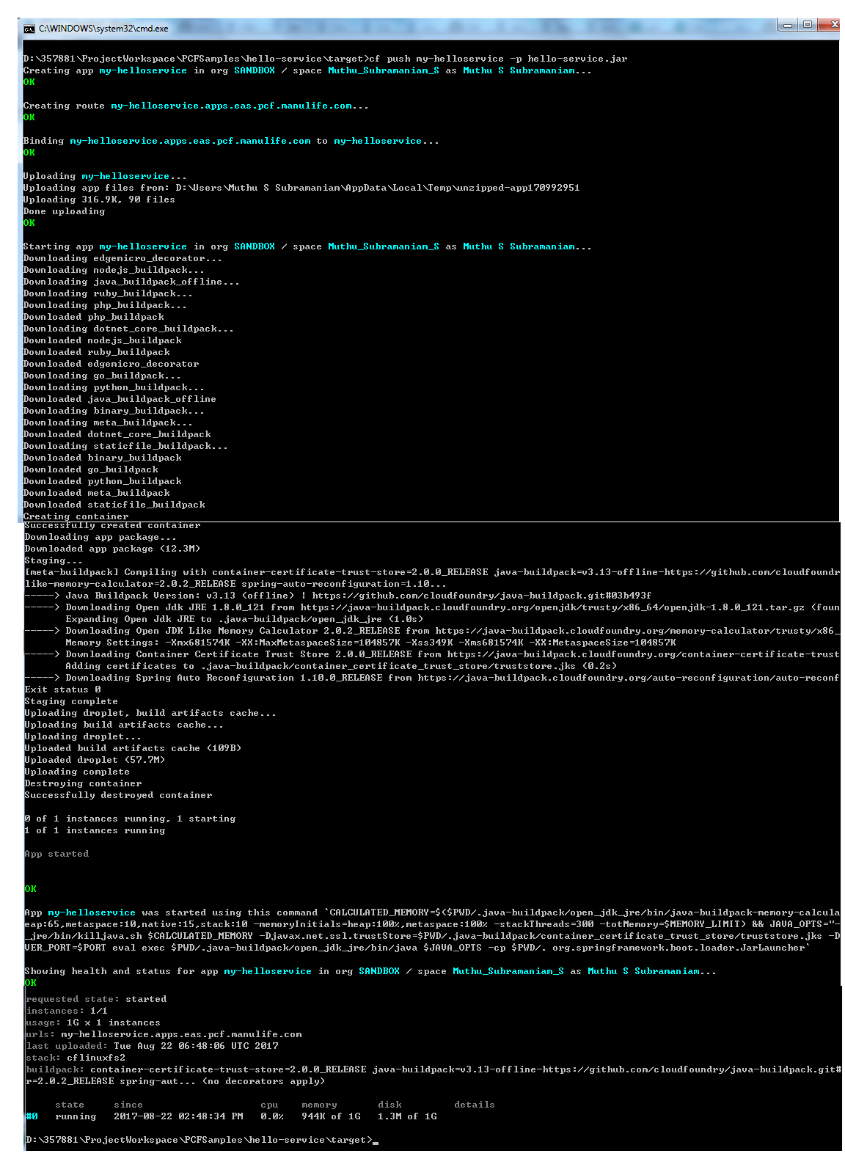
Deployment with PCF – CLI (2/3)
Step 3
Push your application using the cf push command (cf push <appname> -p <jar file name>)
cf push my-helloservice –p hello-service.jar, cf push my-helloservice –p D:/Deployment/hello-service.jar
Advanced CF PUSH command
A more advanced option of the cf push command is give below
(cf push app_name -d apps.eas.pcf.manulife.com --hostname path-sit -m 512m -p your.jar)
cf push helloservice -d apps.eas.pcf.manulife.com --hostname mssand-helloservice -m 512m -p helloservice.jar
Now the application would be accessible at
https://mssand-helloservice.apps.eas.pcf.manulife.com

Slide 7
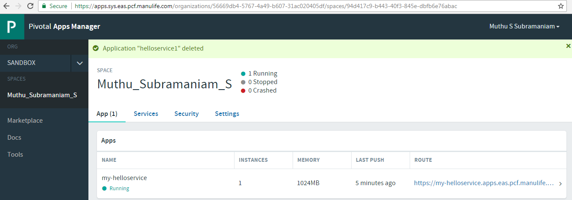
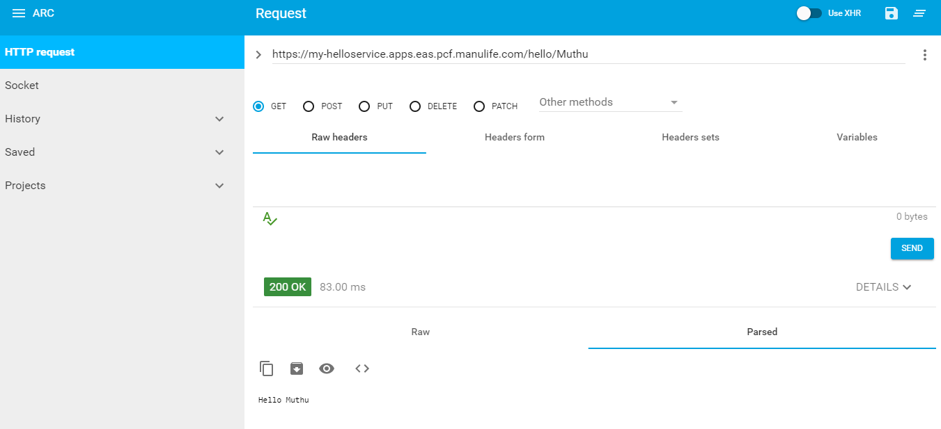
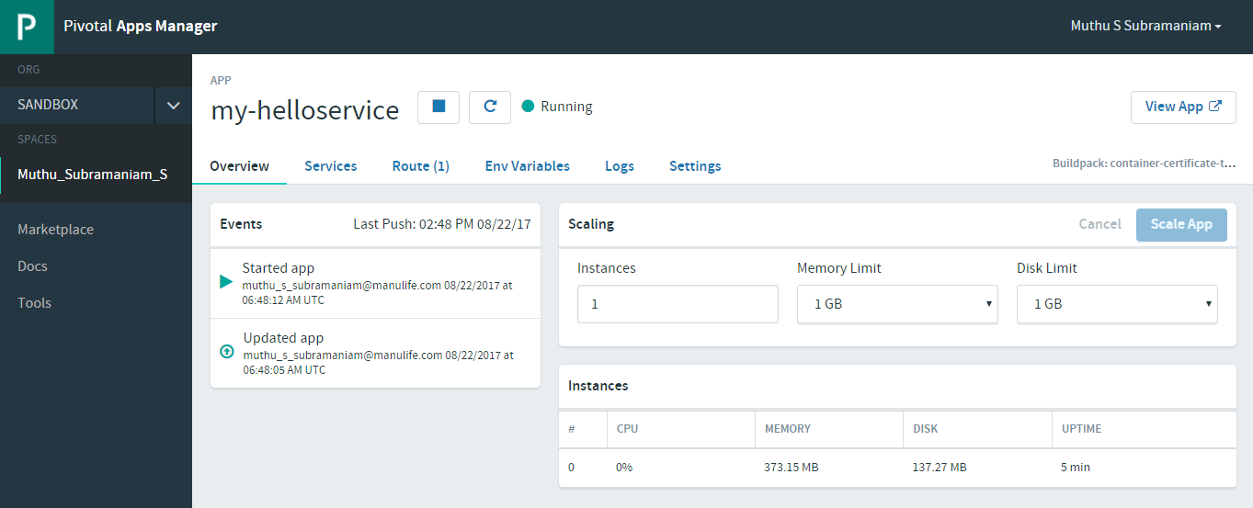
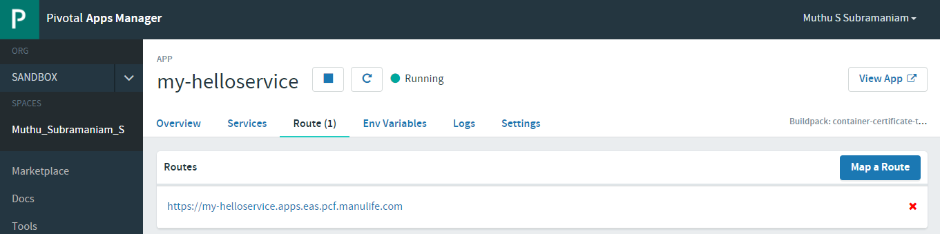
Deployment with PCF – CLI (3/3)
Step 4
Access PCF to verify if the application is successfully deployed and explore the app Overview, Route and Logs Link
Step 5
Test the service with any REST Client

Slide 8
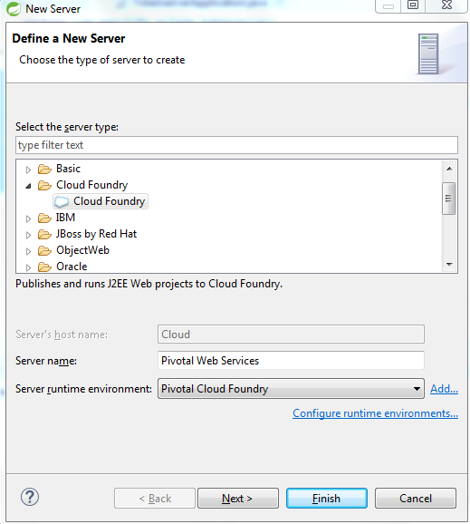
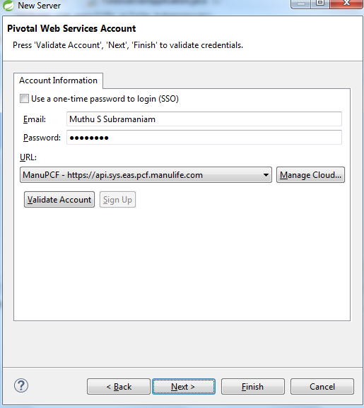
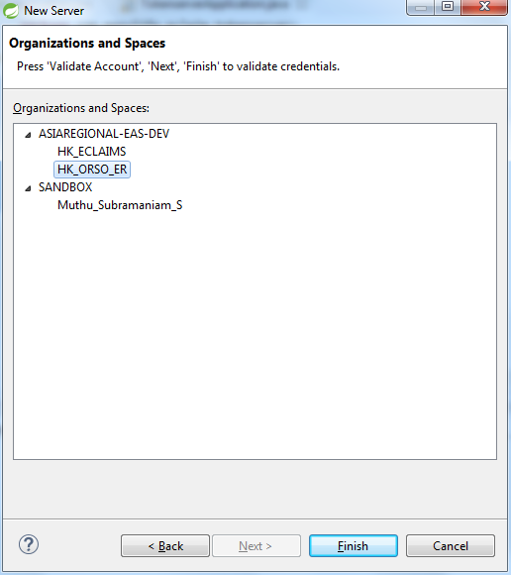
PCF – STS Plugin & Cloud Foundry Server Setup
Step 1
Follow the steps outlined in the below sites to install the PCF plugin in STS (https://docs.pivotal.io/pivotalcf/1-9/buildpacks/java/sts.html#install-to-sts, http://spring.io/blog/2011/04/13/using-cloud-foundry-from-sts/)
Step 2
Create a new Cloud Foundry Server instance connecting to Manulife PCF instance with your LAN ID, Password, ORG and SPACE as shown below

Slide 9
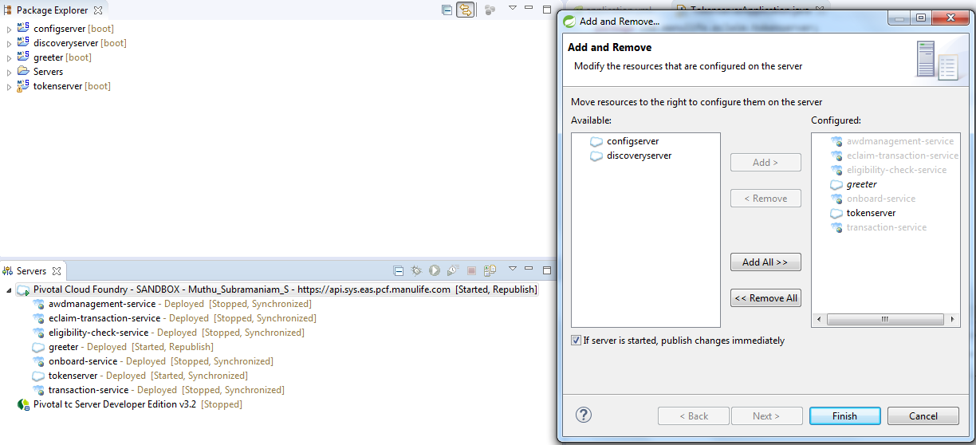
Deployment with PCF Plugin (1/2)
Step 1
Right click on the Cloud Foundry Server to Add (Deploy) application to PCF OR Remove (Undeploy) applications

Slide 10
Deployment with PCF Plugin (2/2)
Step 2
Test the service with any REST Client after the application is pushed to PCF

Slide 11
Next Steps
Next Steps
Create simple spring boot based micro services and deploy with PCF-CLI and PCF-STS Plugin to get comfortable with deploying the application using both the options
Proceed with Config Server POC to understand
Basics of Config Server and integration with BitBucket
Running Config Server in Local Development environment
Sample micro service apps to utilize the configuration from Config Server ( & Bit Bucket)
Configuring PCF Managed Services Config Server ( with Bit Bucket)
Configure sample micro service apps to utilize the configuration from PCF Managed Services Config Server ( & Bit Bucket)
Locating configuration files from other locations, refreshing the configuration values at runtime, environment specific configurations and apply encryption / decryption on configuration parameter

Slide 12

Thank You

